Slide 1
Rush
Hour
By Ebner, Lamplmair, Mayer

Slide 2

01
A* Algorithm

Slide 3

A* implementation Rush Hour
Finding the best possible solution to reach the goal
Minimize f(n) = g(n) + h(n)
Use Open and Closed List
Open List: Java Priority Queue
Closed List: Set
Costs for each move is 1 (=depth)

Slide 4
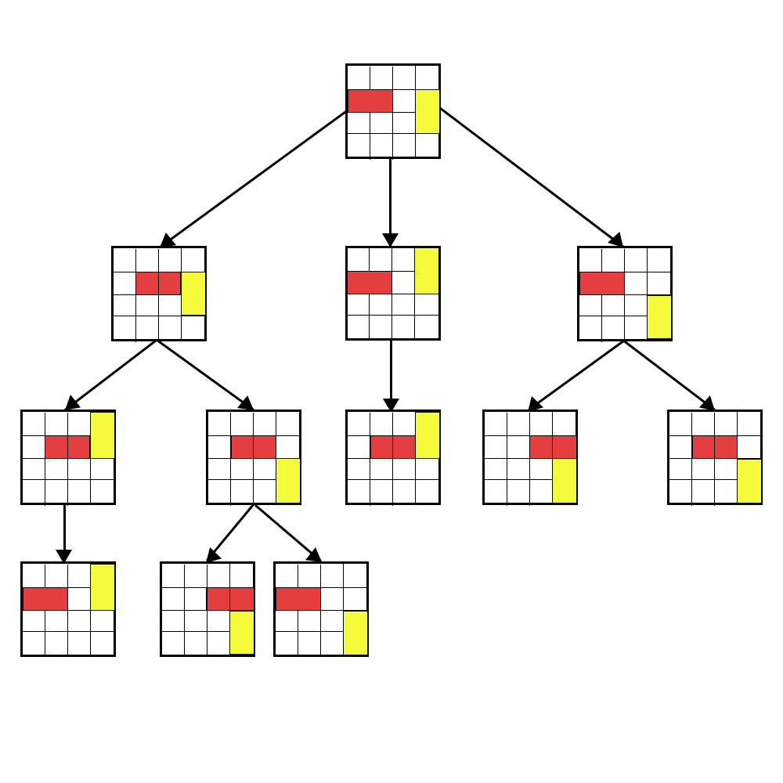
A* implementation Rush Hour
Checking if current state = Goal
Yes => End
Else add Node to closed list / remove from open list
Expand node
Get the cost of the expanded nodes
Node on close list -> ignore Node
Node on open list
Check if costs are better → add better node on open list
Image source: Jelle_van_Dijk_BSc_Thesis_08_06_2018

Slide 5
02
Heuristics

Slide 6
Our Heuristics
Zero
Blocking
Distance (!)
Advanced
Returns 0 for each node. Equals Breadth-First Search
Returns number of cars blocking the goal car
Returns distance of goal car to exit
Returns number of all cars blocking the blocking cars

Slide 7
Admissible and Consistent
“A consistent heuristic never overestimates the distance from any neighboring node to the goal, plus the cost of reaching that neighbor.”
“An admissible heuristic never overestimates the cost to reach the goal.”
ADMISSIBLE
CONSISTENT
Notes:
CONSISTENT HEURISTIC:
A heuristic is consistent if the cost from the current node to a successor node, plus the estimated cost from the successor node to the goal is less than or equal to the estimated cost from the current node to the goal
In an equation, it would look like this: C(n, n’) + h(n’) ≤ h(n)
ADMISSIBLE HEURISTIC:
A heuristic is admissible if the estimated cost is never more than the actual cost from the current node to the goal node.

Slide 8
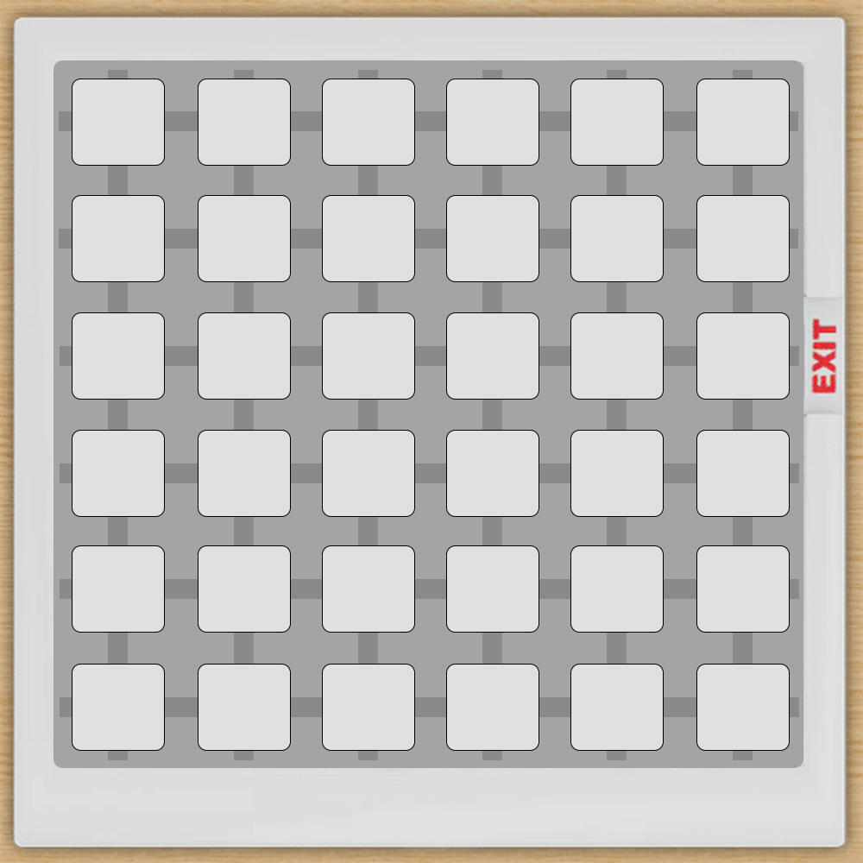





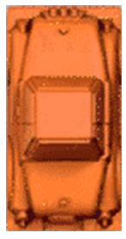

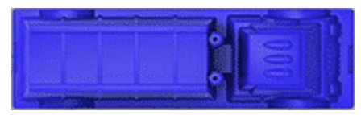
Blocking Heuristic

Slide 9
Blocking Heuristic
Cars don’t block if..
they have same orientation

Slide 10
Blocking Heuristic
Cars don’t block if..
they have same orientation
Their X-position <= end of goal car

Slide 11
Blocking Heuristic
Cars are blocking if..
Their X-position > x of goal car
Their Y-position + size > y of goal car AND Their Y-position <= y of goal car

Slide 12
Advanced Heuristic
Blocking Blocking Heuristic
Checking for blocking cars
Checking if this car get block too
Repeat until no blocking
Move car
Repeat until the main car can drive
Check again for blocking cars
Do Step 2

Slide 13
Advanced Heuristic
Blocking Blocking Heuristic
Checking for blocking cars
Checking if nearest car get block too
Repeat until no blocking
Move car
Repeat until the main car can drive
Check again for blocking cars
Do Step 2

Slide 14
Advanced Heuristic
Blocking Blocking Heuristic
Checking for blocking cars
Checking if this car get block too
Repeat until no blocking
Move car
Repeat until the main car can drive
Check again for blocking cars
Do Step 2

Slide 15
Advanced Heuristic
Blocking Blocking Heuristic
Checking for blocking cars
Checking if this car get block too
Repeat until no blocking
Move car
Repeat until the main car can drive
Check again for blocking cars
Do Step 2

Slide 16
Advanced Heuristic
Blocking Blocking Heuristic
Checking for blocking cars
Checking if this car get block too
Repeat until no blocking
Move car
Repeat until the main car can drive
Check again for blocking cars
Do Step 2

Slide 17
Advanced Heuristic
Blocking Blocking Heuristic
Checking for blocking cars
Checking if this car get block too
Repeat until no blocking
Move car
Repeat until the main car can drive
Check again for blocking cars
Do Step 2

Slide 18
Advanced Heuristic
Blocking Blocking Heuristic
Blocking Blocking Heuristic
Checking for blocking cars
Checking if this car get block too
Repeat until no blocking
Move car
Repeat until the main car can drive
Check again for blocking cars
Do Step 2

Slide 19
Advanced Heuristic
Blocking Blocking Heuristic
Checking for blocking cars
Checking if this car get block too
Repeat until no blocking
Move car
Repeat until the main car can drive
Check again for blocking cars
Do Step 2

Slide 20
Advanced Heuristic
Blocking Blocking Heuristic
Checking for blocking cars
Checking if this car get block too
Repeat until no blocking
Move car
Repeat until the main car can drive
Check again for blocking cars
Do Step 2

Slide 21
Advanced Heuristic
Blocking Blocking Heuristic
Checking for blocking cars
Checking if this car get block too
Repeat until no blocking
Move car
Repeat until the main car can drive
Check again for blocking cars
Do Step 2

Slide 22
Advanced Heuristic
Blocking Blocking Heuristic
Blocking Blocking Heuristic
Checking for blocking cars
Checking if this car get block too
Repeat until no blocking
Move car
Repeat until the main car can drive
Check again for blocking cars
Do Step 2

Slide 23
Advanced Heuristic
Blocking Blocking Heuristic
Checking for blocking cars
Checking if this car get block too
Repeat until no blocking
Move car
Repeat until the main car can drive
Check again for blocking cars
Do Step 2

Slide 24
Advanced Heuristic
Blocking Blocking Heuristic
Checking for blocking cars
Checking if this car get block too
Repeat until no blocking
Move car
Repeat until the main car can drive
Check again for blocking cars
Do Step 2

Slide 25
Both the blocking and the advanced heuristic are consistent
All blocking cars need at least one move to get out of the way
Never overestimates the real costs

Slide 26
Distance to Goal
Checking the distance to the goal
Moves goal car and check if the distance = 0
Not admissible because the distance could be more than steps needed
H = 3
H = 3

Slide 27
2. Advanced Heuristic
Blocking Blocking Distance
Combination of Distance & Blocking Blocking
Not admissible

Slide 28
03
Analysis

Slide 29
Comparison
| | Zero | Blocking | Distance | Advanced | AdvancedDistance|
|name | nodes dpth br.fac | nodes dpth br.fac | nodes dpth br.fac | nodes dpth br.fac | nodes dpth br.fac|
|-----------+-----------------------+-----------------------+-----------------------+-----------------------+----------------------|
|Jam-1 | 11589 8 3,066 | 6829 8 2,857 | 9561 9 2,625 | 991 8 2,196 | 959 8 2,186|
|Jam-2 | 24081 8 3,378 | 4044 8 2,663 | 11407 9 2,681 | 2643 9 2,248 | 1570 8 2,340|
|Jam-3 | 7731 14 1,788 | 4059 14 1,699 | 4249 15 1,639 | 3688 14 1,686 | 3410 15 1,613|
|Jam-4 | 3203 9 2,301 | 1281 9 2,057 | 2707 9 2,255 | 409 9 1,781 | 206 9 1,627|
|Jam-5 | 21390 9 2,888 | 5075 9 2,433 | 15724 11 2,284 | 668 9 1,896 | 398 9 1,774|
|Jam-6 | 15992 9 2,791 | 6567 9 2,510 | 12786 11 2,239 | 2287 10 2,025 | 2465 11 1,901|
|Jam-7 | 52493 13 2,202 | 20143 13 2,035 | 24401 14 1,955 | 19262 13 2,027 | 18272 13 2,018|
Heuristics using the Distance are performing good but are not admissible.
Our Advanced Heuristic performed way better than the Blocking (and Zero)

Slide 30
Analysis
The more cars clustered in one spot, the harder it was for the algorithm to get to a solution
Clusters were detected and resolved with more ease by humans
E.g. 7, 14, 24
The more intricate blocking dependencies were, the harder it was for the human eye and mind to have an overview over the situation as only a few moves could be thought through before moving

Slide 31
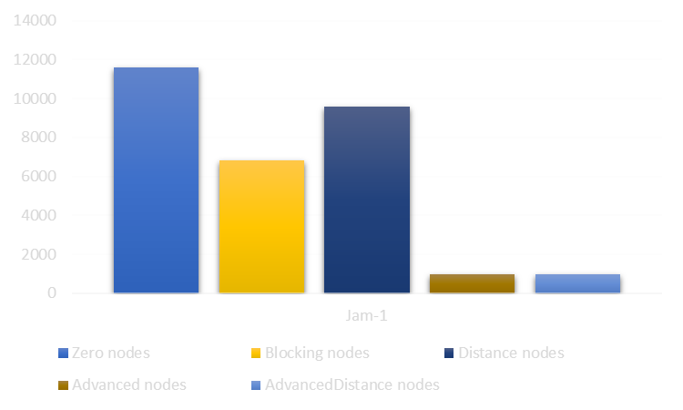
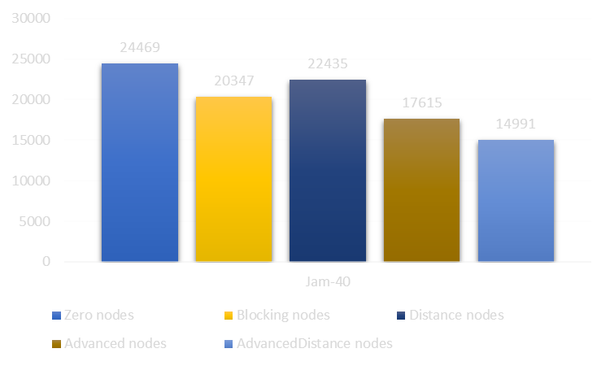
Analysis
The influence of the heuristics on the expanded nodes decreases with increasing puzzle difficulty.

